Slide 1


CS-446: Information Systems Security
Chapter # 10: Digital Signature, Public Key Certificates and Public Key Infrastructure
Prof. Dr. Sufian Hameed
Department of Computer Science
FAST-NUCES

Slide 2
Overview
What will you learn today
Digital Signatures
Public key and Signature
Public Key Infrastructure
Identity Based Encryption

Slide 3
A digital signature is a mathematical scheme for verifying the authenticity of digital messages or documents. A valid digital signature, where the prerequisites are satisfied, gives a recipient very strong reason to believe that the message was created by a known sender (authentication), and that the message was not altered in transit (integrity).
Digital signatures are a standard element of most cryptographic protocol suites, and are commonly used for software distribution, financial transactions, contract management software, and in other cases where it is important to detect forgery or tampering

Slide 4
Digital Signature
Authentication and Non-Repudiation
Gives a recipient reason to believe that the message was created by a known sender such that they cannot deny sending it
Integrity
The message was not altered in transit
Notes:
Non-repudiation refers to a state of affairs where the purported maker of a statement will not be able to successfully challenge the validity of the statement or contract

Slide 5
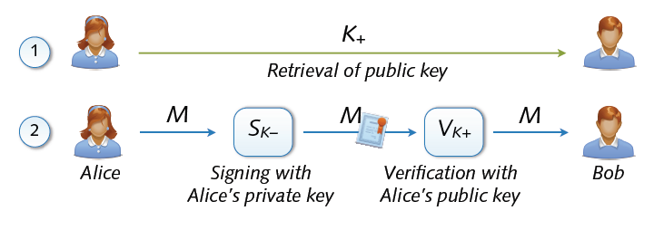
Digital Signature
Digital signing: reverse application of public-key system
Signing = encryption with private key
Verification = decryption with public key

Slide 6
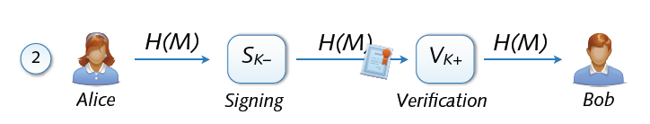
Signing and Hashing
Encryption and decryption of large messages inefficient
Signing of hash H(M) instead of message M
Verification of message M using signed hash H(M)
One-way property: hard to find M’ with H(M’) = H(M)
Support for signing emails, images, videos, ...

Slide 7
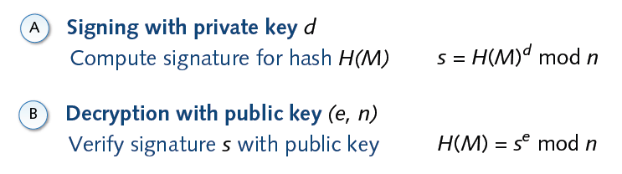
Signature and RSA

Slide 8
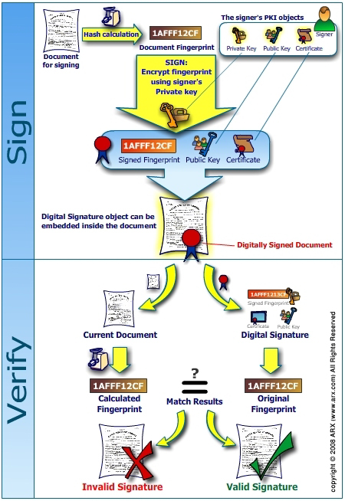
`

Slide 9
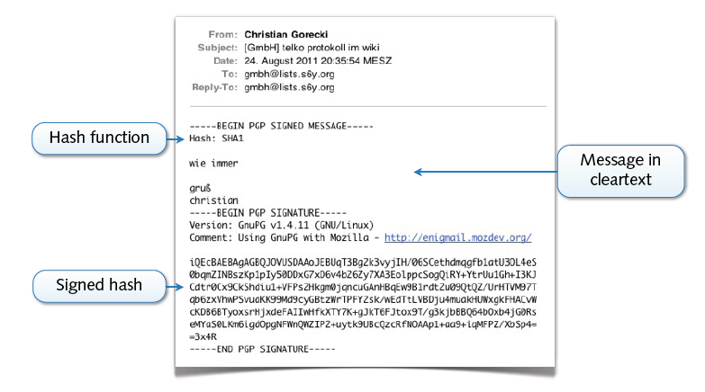
Example: PGP Signature

Slide 10
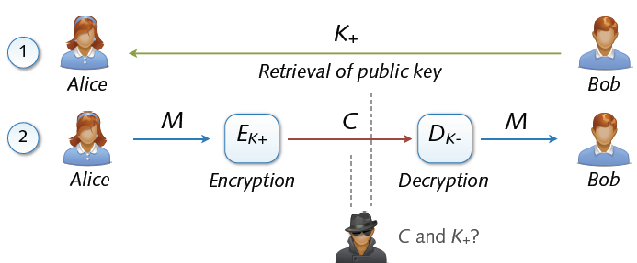
Asymmetric Cryptosystem
Asymmetric cryptosystems
Asymmetric encryption and decryption
K+ (pk) = public key of Bob K– (sk) = secret key of Bob
No secure key exchange necessary

Slide 11
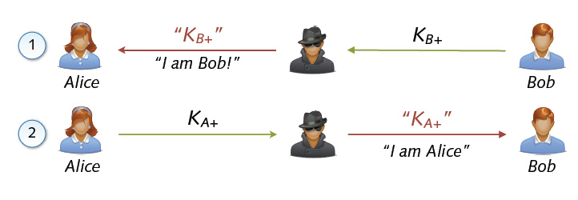
Man in the Middle (MITM)
Common attack against asymmetric cryptosystems
Interception of public key exchange by attacker
Transparent eavesdropping using forged keys

Slide 12
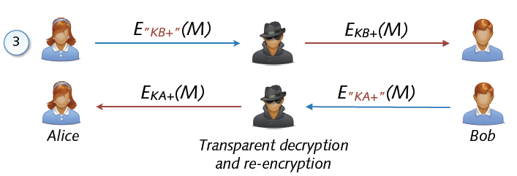
Man in the Middle (MITM)
Attacker invisible to both parties
Received data encrypted with correct public key
Sent data encrypted with forged public keys

Slide 13
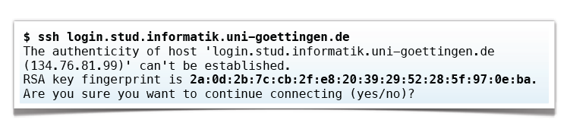
Key Fingerprints
Protection against MITM using key fingerprints
Manual comparison of public keys using hash values
Storage of approved public keys in database
Example: SSH client presents fingerprint for validation
Secure exchange of fingerprints required (hen-egg problem)

Slide 14
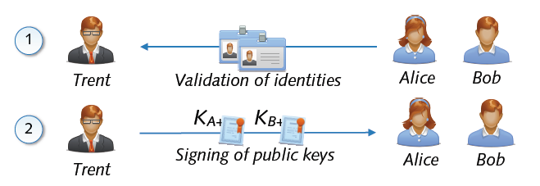
Public Key and Signatures
Problem: Public keys not linked to identity of user
Solution: Validation and signing of public key by third party
Certification of link between identity and public key
Acceptance of signed public keys only → no MITM attack

Slide 15
public key certificate, also known as a digital certificate or identity certificate

Slide 16
In cryptography, a public key certificate, also known as a digital certificate or identity certificate, is an electronic document used to prove the ownership of a public key.^{[1]}
The certificate includes information about the key, information about the identity of its owner (called the subject), and the digital signature of an entity that has verified the certificate's contents (called the issuer).
If the signature is valid, and the software examining the certificate trusts the issuer, then it can use that key to communicate securely with the certificate's subject.
In email encryption, code signing, and e-signature systems, a certificate's subject is typically a person or organization. However, in Transport Layer Security (TLS) a certificate's subject is typically a computer or other device, though TLS certificates may identify organizations or individuals in addition to their core role in identifying devices. TLS, sometimes called by its older name Secure Sockets Layer (SSL), is notable for being a part of HTTPS, a protocol for securely browsing the web.

Slide 17
Public key infrastructure (PKI)

Slide 18
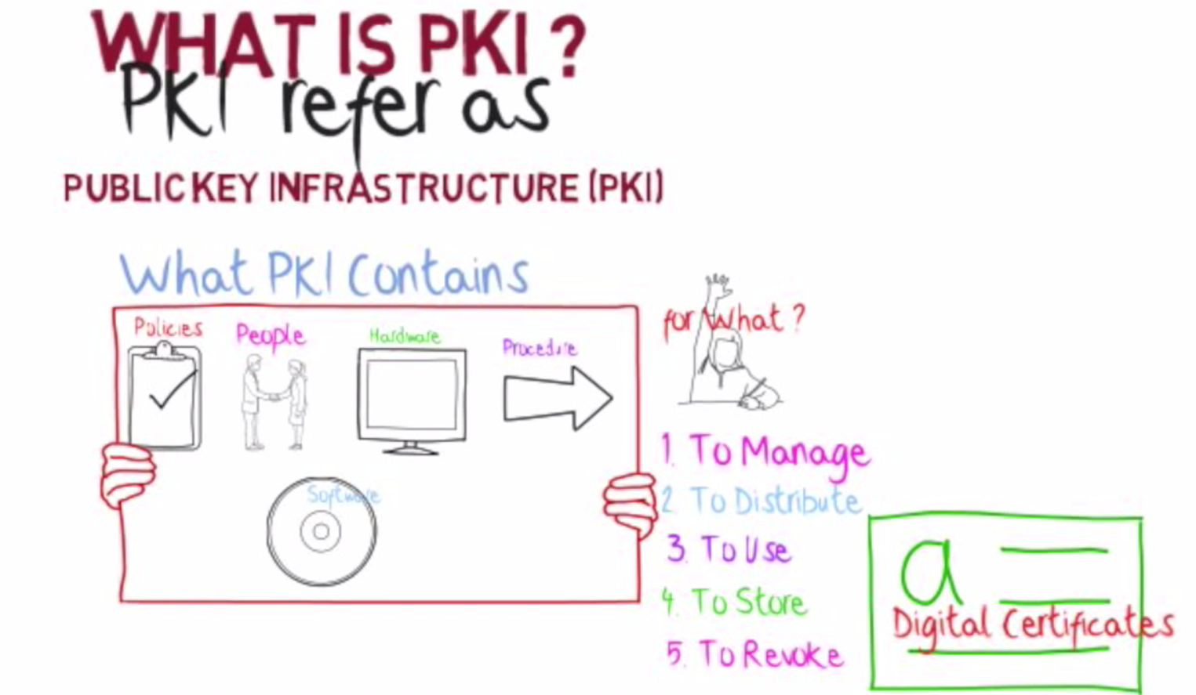

Slide 19
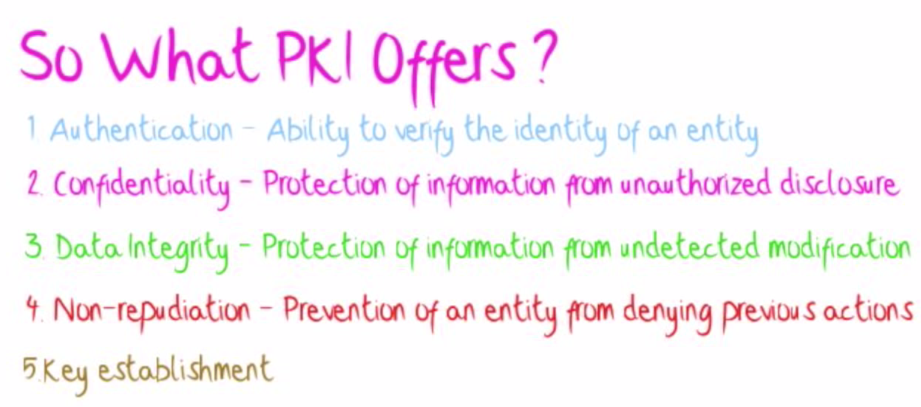

Slide 20
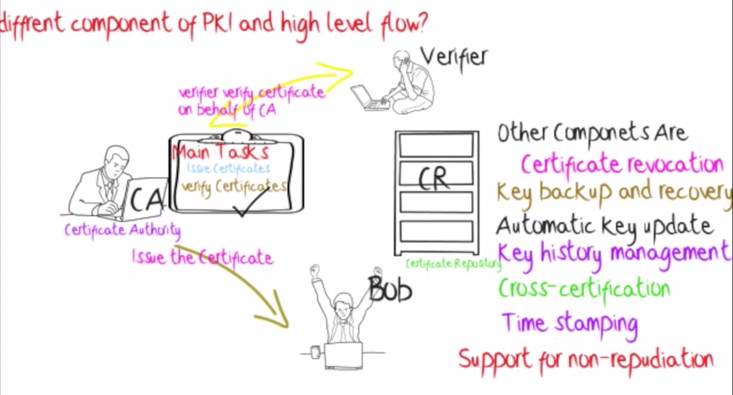

Slide 21
Design:
Public key cryptography is a cryptographic technique that enables entities to securely communicate on an insecure public network, and reliably verify the identity of an entity via digital signatures.^{[5]}
A public key infrastructure (PKI) is a system for the creation, storage, and distribution of digital certificates which are used to verify that a particular public key belongs to a certain entity.
The PKI creates digital certificates which map public keys to entities, securely stores these certificates in a central repository and revokes them if needed.^{[6][7][8]}
A PKI consists of:^{[7][9][10]}
A certificate authority (CA) that stores, issues and signs the digital certificates;
A registration authority (RA) which verifies the identity of entities requesting their digital certificates to be stored at the CA;
A central directory—i.e., a secure location in which keys are stored and indexed;
A certificate management system managing things like the access to stored certificates or the delivery of the certificates to be issued;
A certificate policy stating the PKI's requirements concerning its procedures. Its purpose is to allow outsiders to analyze the PKI's trustworthiness.

Slide 22
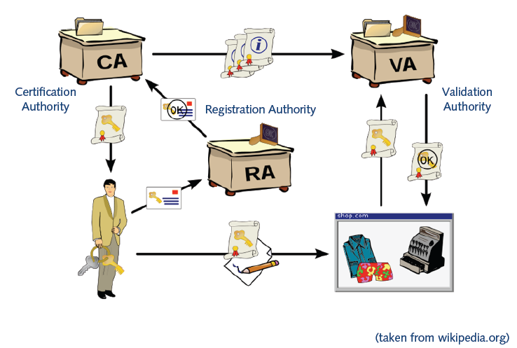
Roles In PKI
*from wiki

Slide 23
A public key infrastructure (PKI) is a set of roles, policies, hardware, software and procedures needed to create, manage, distribute, use, store and revoke digital certificates and manage public-key encryption.
The purpose of a PKI is to facilitate the secure electronic transfer of information for a range of network activities such as e-commerce, internet banking and confidential email.
It is required for activities where simple passwords are an inadequate authentication method and more rigorous proof is required to confirm the identity of the parties involved in the communication and to validate the information being transferred.
In cryptography, a PKI is an arrangement that binds public keys with respective identities of entities (like people and organizations).
The binding is established through a process of registration and issuance of certificates at and by a certificate authority (CA).
Depending on the assurance level of the binding, this may be carried out by an automated process or under human supervision.

Slide 24
Public Key Certificates
Electronic document that uses a digital signature to bind a public key with an identity
Information such as the name of a person or an organization, their address, and so forth.
The certificate can be used to verify that a public key belongs to an individual.
Two Types of Signature on a Certificate
In public key infrastructure (PKI) scheme
Signature will be of a certificate authority (CA).
In web of trust scheme
Signature is of either the user (a self-signed certificate) or other users ("endorsements").
In either case, the signatures on a certificate are attestations by the certificate signer that the identity information and the public key belong together.
*from wiki

Slide 25
In a typical public-key infrastructure (PKI) scheme, the certificate issuer is a certificate authority (CA), usually a company that charges customers to issue certificates for them.
By contrast, in a web of trust scheme, individuals sign each other's keys directly, in a format that performs a similar function to a public key certificate.
The most common format for public key certificates is defined by X.509.^{[2]} Because X.509 is very general, the format is further constrained by profiles defined for certain use cases, such as Public Key Infrastructure (X.509) as defined in RFC 5280

Slide 26
Issuing a certificate
A CA issues digital certificates that contain a public key and the identity of the owner.
The matching private key is not made available publicly, but kept secret by the end user who generated the key pair.
The certificate is also a confirmation or validation by the CA that the public key contained in the certificate belongs to the person, organization, server or other entity noted in the certificate.
A CA's obligation in such schemes is to verify an applicant's credentials, so that users and relying parties can trust the information in the CA's certificates.
CAs use a variety of standards and tests to do so.
In essence, the certificate authority is responsible for saying "yes, this person is who they say they are, and we, the CA, certify that".^{[24]}
If the user trusts the CA and can verify the CA's signature, then they can also assume that a certain public key does indeed belong to whoever is identified in the certificate.

Slide 27
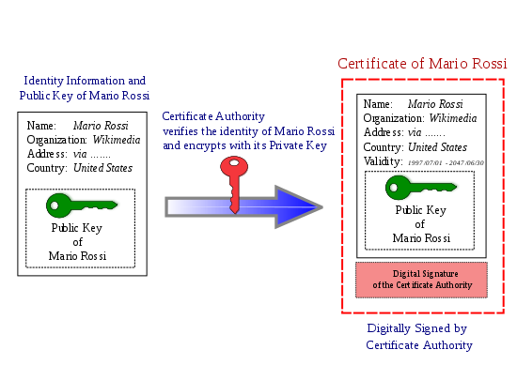

Slide 28
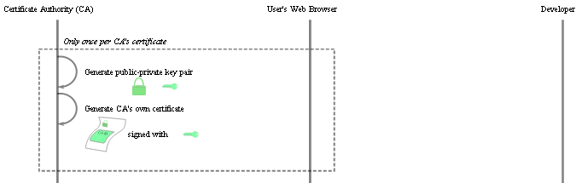
Certificate Creation (Step 1)
*from wiki
Notes:
A random element in Z_N is *very* likely to be in Z_N^*

Slide 29
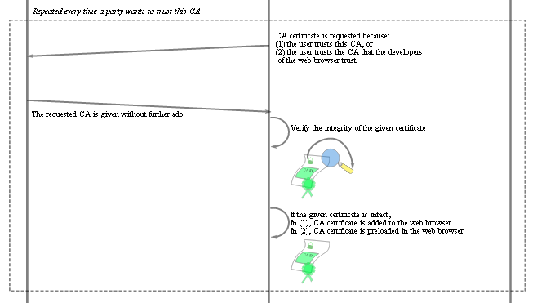
Certificate Creation (Step 2)
*from wiki
Notes:
A random element in Z_N is *very* likely to be in Z_N^*

Slide 30

Certificate Creation (Step 3)
*from wiki
Notes:
A random element in Z_N is *very* likely to be in Z_N^*

Slide 31
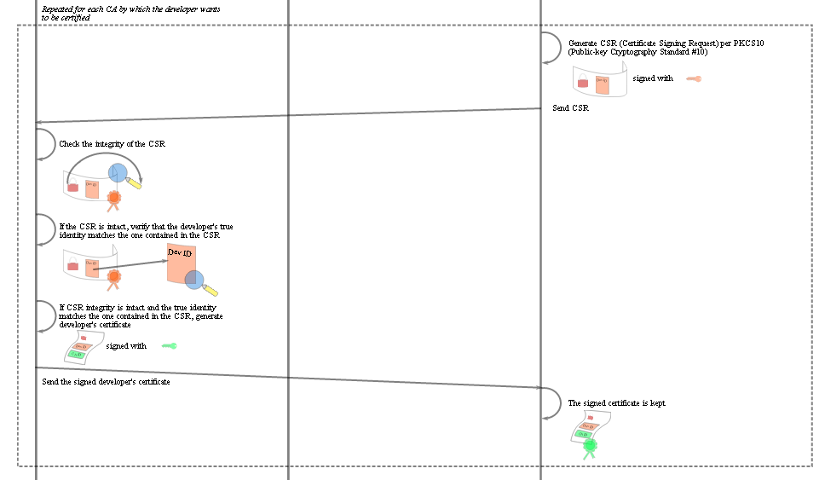
Certificate Creation (Step 4)
*from wiki
Notes:
A random element in Z_N is *very* likely to be in Z_N^*

Slide 32
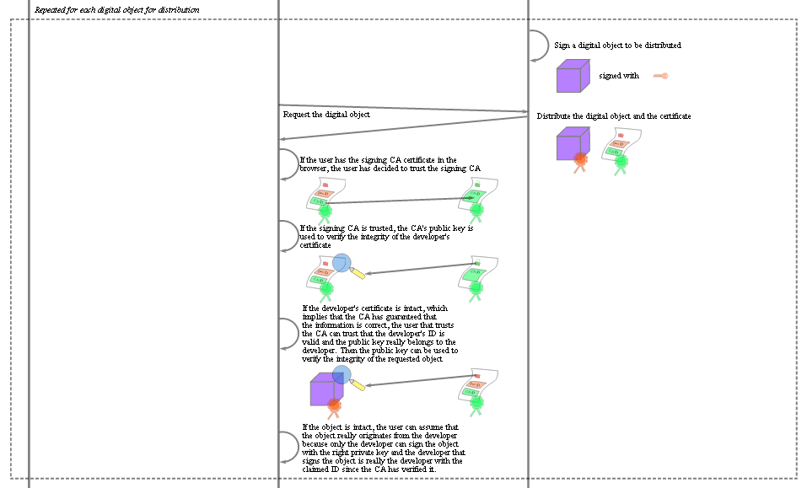
Certificate Creation (Step 5)
*from wiki
Notes:
A random element in Z_N is *very* likely to be in Z_N^*

Slide 33
Contents of Typical Digital Certificate
Serial Number: Used to uniquely identify the certificate.
Subject: The person, or entity identified.
Signature Algorithm: The algorithm used to create the signature.
Signature: The actual signature to verify that it came from the issuer.
Issuer: The entity that verified the information and issued the certificate.
Valid-From: The date the certificate is first valid from.
Valid-To: The expiration date.
Key-Usage: Purpose of the public key (e.g. encipherment, signature, certificate signing...).
Public Key: The public key.
Thumbprint Algorithm: The algorithm used to hash the public key certificate.
Thumbprint: The hash itself, used as an abbreviated form of the public key certificate.
*from wiki

Slide 34
Vendor defined classes
VeriSign uses the concept of classes for different types of digital certificates
Class 1 for individuals, intended for email.
Class 2 for organizations, for which proof of identity is required.
Class 3 for servers and software signing, for which independent verification and checking of identity and authority is done by the issuing certificate authority.
Class 4 for online business transactions between companies.
Class 5 for private organizations or governmental security.
Other vendors may choose to use different classes or no classes at all as this is not specified in the PKI standards.
*from wiki

Slide 35
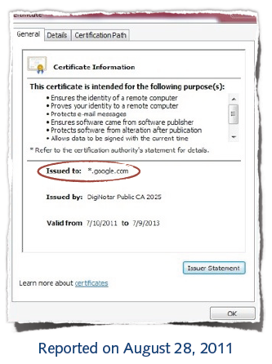
No more MITM?
Case: Forged Google certificate
Issued by legitimate CA
Valid for *.google.com
Used by unknown holder
Reported by Iranian users
Large-scale attack against CA
Break-in at CA DigitNotar
539 forged certificates

Slide 36

Public Key Infrastructure (PKI)
Public-key infrastructure (PKI) is a set of hardware, software, people, policies, and procedures needed to create, manage, distribute, use, store, and revoke digital certificates.
Management of trust using public-key cryptography
Digital certificates (signatures) on keys, attributes, ...
Certificate authorities (CA) as trusted parties
Chain of trust with multiple layers
Different architectures
Hierarchical PKI,
e.g. X.509 standard
Web of trust,
e.g. PGP software

Slide 37
Roles In PKI
Certification Authority (CA)
Trusted third party that binds public keys with respective user identities
Validation Authority (VA)
The user identity must be unique within each CA domain. The third-party Validation Authority (VA) can provide this information on behalf of CA.
Registration Authority (RA)
The binding is established through the registration and issuance process, which, depending on the level of assurance the binding has, may be carried out by software at a CA, or under human supervision. The PKI role that assures this binding is called the Registration Authority (RA). The RA ensures that the public key is bound to the individual to which it is assigned in a way that ensures non-repudiation.
*from wiki

Slide 38
Acknowledgements
Material in this lecture are taken from the slides prepared by:
Prof. Dr. Konrad Rieck (Uni-Göttingen)

